Slide 1




Capstone & Research 1
DATAFLOW DIAGRAM
(LEVEL 0 & LEVEL 1)
Presented by: GROUP 2

Slide 2





Group Presenters
Margaret Mangulabnan
Dhanna Kimberly Bernal
Nerma Hernandez
Reymel Dela Cruz

Slide 3

AGENDA
01 | Objectives
02 | Overview
03 | What is Context Diagram (Level 0 DFD)?
04 | How Context Diagram (Lvl 0 DFD) Works?
05 | Rules for naming ELEMENTS in Level 0 DFD / Context Diagram
06 | TOOLS
07 | What is Level 1 DFD
08 | How Lvl. 1 Data Flow Diagram?
09 | Contents & Basic Elements of Level 1 DFD
10 | Do’s and Don'ts in making Level 1 Data Flow Diagram
11 | Naming Rules
12 | CONCLUSION

Slide 4



Overview
A Data Flow Diagram (DFD) shows how information moves within a system. The Level 0 DFD, or Context Diagram, gives a high-level view of the system and its interaction with external entities. Level 1 (DFD) breaks this view into smaller processes, providing more detail on how the system works internally.

Slide 5


What is Context Diagram
(Level 0 DFD)?
A Context Diagram or Level 0 DFD provides a high-level view of a system, showing it as a single process and how it interacts with external entities like users or other systems. It illustrates the flow of information in and out of the system and defines its boundaries. This diagram helps stakeholders and developers quickly understand the system’s overall function and scope before looking at internal processes in detail.

Slide 6
Rules for naming ELEMENTS in Level 0 DFD / Context Diagram
In Level 0 DFD (Context Diagram), the main process represents the entire system.
The name of the process should be the name of your system.
Example: If the system is an Enrollment System, the process name is Enrollment System.
Example: If the system is a Payroll System, the process name is Payroll System.
Key Point:
The process in Level 0 always reflects the system as a whole, making it easy to identify at a glance.

Slide 7
Rules for naming ELEMENTS in Level 0 DFD / Context Diagram
2
4
Data Stores (if applicable in Level 0)
External Entities
Use specific names for users, organizations, or other systems interacting with your system.
Example: Student, Administrator, Bank System.
Avoid vague terms like User or System without context.
If shown, use descriptive names reflecting what data is stored.
Example: Student Records, Payroll Database.
3
Data Flows
Name data flows according to the type of information being sent or received.
Use nouns or short phrases, not verbs.
Example: Student Information, Payment Details, Enrollment Request.
Tip: Keep names consistent, meaningful, and easy to understand for anyone reading the diagram.

Slide 8
What is Level 1
Data Flow Diagram?
A Level 1 DFD breaks down the system from the Context Diagram (Level 0 DFD) into sub-processes, showing how data flows between them, external entities, and data stores. It provides a detailed view of the system’s internal operations, helping stakeholders and developers understand how information is processed, stored, and transferred.

Slide 9

How does it WORK?
KEY POINTS:
Symbols and Conventions
Proper symbols are used for processes, data stores, external entities, and data flows. Naming must follow conventions to avoid confusion.
DFD Styles
There are two main styles—Gane & Sarson and DeMarco & Yourdon. In this module, we focus on Gane & Sarson symbols, which are commonly used in universities and capstone projects.
Purpose
Level 1 DFD clarifies the functional structure of the system, showing how information is processed, stored, and transmitted internally.

Slide 10

Contents & Basic
Elements of Level 1 DFD
Represents a function or activity that transforms input data into output.
Symbol: Rounded rectangle with a line on top showing the process name.
Shows where data is processed in the system; naming must follow proper rules.
PROCESS

Slide 11
Contents & Basic
Elements of Level 1 DFD
A Data Flow represents the movement of data between different parts of the system, such as processes, data stores, and external entities.
Its symbol is displayed as an arrow in the diagram. The direction of an arrow shows where the data is going.
It’s what connects all the elements together and shows where and how data travels inside the system.
DATA FLOW

Slide 12
Contents & Basic
Elements of Level 1 DFD
A Data Store is where the system keeps or store data. When a process needs to save information, that data goes into a data store.
Its symbol looks like a rectangle wth an open side or a line on one corner.
It acts like the system’s storage or database, when data can be kept and later retrieved by one or more processes.
DATA STORE

Slide 13
Contents & Basic
Elements of Level 1 DFD
An Entity is the source or destination of the data. Also called a “data source”, an “endpoint”, or a “terminator” because it is where data comes from and where data goes.
Simple terms, an entity is outside the system but interacts with it
Ex: Students, customers, or another system that sends data or receives data from your system.
ENTITY

Slide 14




Naming Rules for Processes
Each process must have a proper name format.
The name should include:
Examples of proper process names:
Prepare Certificate of Registration (Verb + Noun)
Verify Customer Information (Verb + Adjective + Noun)
Compute Sales Tax (Verb + Adjective + Noun)
This is because a process should describe an action, something a system does.
When proceeding to Level 1 in a Data Flow Diagram (DFD), start showing the detailed processes inside the system.
Each process name must start with an action word (verb)
Avoid naming a process using only nouns
Always make sure the name describes what the process does
If unsure how to name it, think: “What action happens in this process?”

Slide 15


Naming Rules for Data Flow
When naming a Data Flow in a Data Flow Diagram (DFD), the name should always be a singular noun and not plural.
Example:
“Student Record”
“Student Records”
TAKE NOTE:
A single process can have many data flows.
These arrows show different kinds of information entering or leaving the process.
This is because each data flow represents one type of information moving in the system.

Slide 16
Do’s and Don'ts in making Level 1 Data
Flow Diagram
All data flows must go to or from a process. Every flow must start or end at a process.
A Data Store cannot connect directly to another Data Store. A process must be in the middle because only a process can read or write data.
An Entity cannot connect directly to another Entity. Entities are outside the system, so they must connect through a process.
CORRECT FLOW
CORRECT FLOW
Processes can connect directly to other processes. It is the only allowed direct connection.

Slide 17
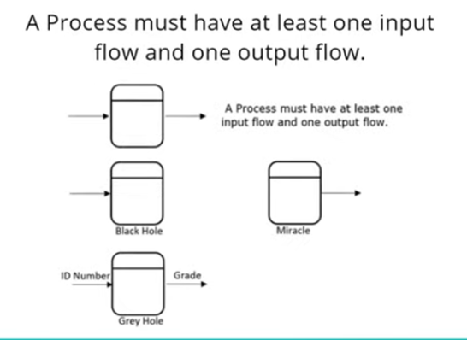
Do’s and Don'ts in making Level 1 Data Flow Diagram
08/10
In a DFD, processes must follow input-output rules, so the diagram makes sense and does not create logical errors.
1. A Process must have at least one input and one output.
3. Miracle is a wrong process. It has output but NO input.
Meaning: the process produces data out of nowhere.
Example: A student suddenly gets a grade ⟶ but no requirements or input were given.
2. Black Hole is a wrong process. It has input but NO output.
4. Grey Hole is a logical error process. It has an input, but it’s NOT enough to produce the output.
Meaning: the process receives data but produces nothing.
Example: Student submits requirements
⟶ but no grade or response is produced.
Meaning: the input is insufficient or incomplete for the output shown.
Example:
Input: Only the student’s ID number
Output: Full grade
⟶ Not enough information to produce that output.

Slide 18
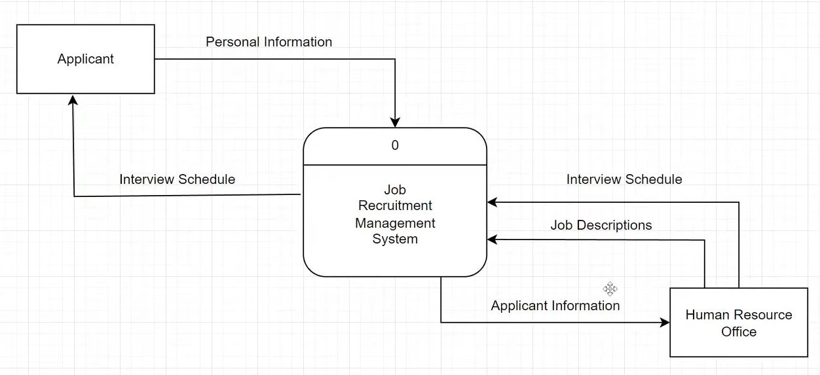
The purpose of a Context Diagram (Level 0 DFD) is to define the system boundaries and provide a simplified understanding of how the system interacts with its environment.

Slide 19
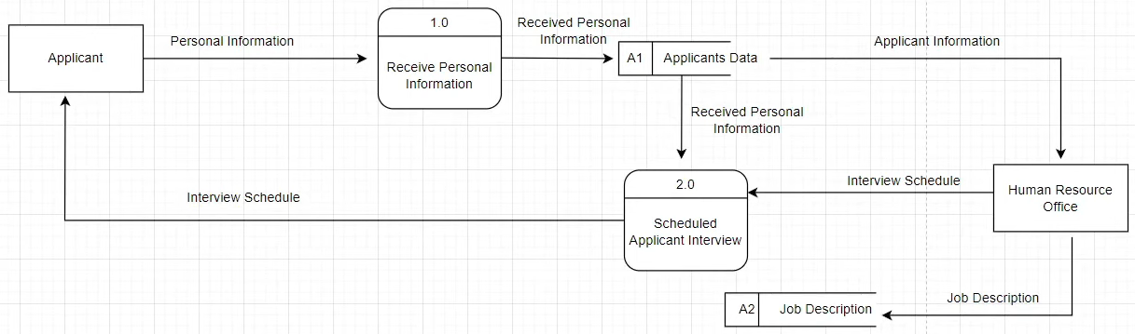
The Level 1 DFD shows how the system works internally, detailing how data is processed, stored, and moved between different parts of the system.

Slide 20

CONCLUSION
As we end this topic, remember that Level 0 DFD (Context Diagram) gives us the big picture of a system, showing its main process and external interactions, while Level 1 DFD breaks it down into detailed sub-processes, showing how data flows internally. Understanding both levels helps us analyze, design, and visualize systems clearly, making it easier to work on projects and real-world applications.

Slide 21
Thank You!

